Slide 1
Physical Climate Modeling: A New Project-Based Climate Modeling Course at Dickinson College
David Reed
Dickinson College

Slide 2
The Course Goals
Introduction to the Earth’s climate system

Slide 3
The Course Goals
Introduction to the Earth’s climate system
Basic modeling skills in three computer language

Slide 4
The Course Goals
Introduction to the Earth’s climate system
Basic modeling skills in three computer language
Connecting to and applying first/second year math and physics topics

Slide 5
The Course Goals
Introduction to the Earth’s climate system
Basic modeling skills in three computer language
Connecting to and applying first/second year math and physics topics
Team based learning with individual end-of-semester projects

Slide 6
The Course Goals
Introduction to the Earth’s climate system
Basic modeling skills in three computer language
Connecting to and applying first/second year math and physics topics
Team based learning with individual end-of-semester projects
Prepare students for graduate level modeling

Slide 7
The Challenges
Introduction to the Earth’s climate system

Slide 8
The Challenges
Introduction to the Earth’s climate system
Basic modeling skills in three computer language

Slide 9
The Challenges
Introduction to the Earth’s climate system
Basic modeling skills in three computer language
Connecting to and applying first/second year math and physics topics

Slide 10
The Challenges
Introduction to the Earth’s climate system
Basic modeling skills in three computer language
Connecting to and applying first/second year math and physics topics
Team based learning with individual end-of-semester projects

Slide 11
The Challenges
Introduction to the Earth’s climate system
Basic modeling skills in three computer language
Connecting to and applying first/second year math and physics topics
Team based learning with individual end-of-semester projects
Prepare students for graduate level modeling

Slide 12
My Goals Today
Convince you that an undergrad-level climate modeling course is possible by a non-climate-modeler
Highlight how the course is structured and my thinking about the layout
Explain the textbook(s) I’ll be working from
Get feedback on your experiences

Slide 13
Assumptions
Students will have working knowledge of
Calculus/matrix math
Physics/thermodynamics
On average, both climate science and programming will be new to the students
One, 14-week course with limited pre-reqs

Slide 14
Climate Modeling
Critical Understanding
Graduate Level Work
Coupled Climate Model
Future Scenarios
Process Model
Anthropogenic Effects
MODELING
CLIMATE SCIENCE
Box/Flux Models
Carbon Cycling
3-D Energy Balance Model
Water Cycling
1-D Energy Balance Model
Earth’s Energy Balance

Slide 15
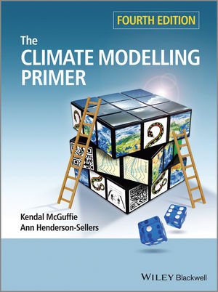
Climate Modeling
Not tied to any programing language
Very well done companion website
Only/best undergrad level text

Slide 16
Climate Modeling
Modeling in three languages
Starting with well-known Excel
1-D energy balance model
After the first taste of climate science, allow students to add one new component (clouds, orbital parameters, land surface changes)

Slide 17
Climate Modeling
Modeling in three languages
Starting with well-known Excel
1-D energy balance model
After the first taste of climate science, allow students to add one new component (clouds, orbital parameters, land surface changes)
The “core” of the course will be in MATLAB, most well known for the instructor
Re-code the 1-D energy balance model into MATLAB
Build 2-D and 3-D models in groups, adding processes when needed
End with a working “toy” coupled-climate model

Slide 18
Climate Modeling
Toy Climate Model
Solar Input/Parameters
Atmosphere/Clouds
Cryosphere
Land Surface /Biology
Ocean

Slide 19
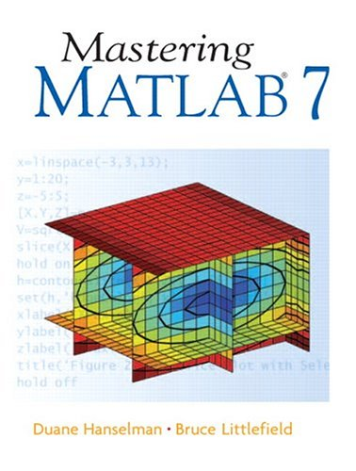
Climate Modeling
MATLAB
Course-pack with selections from multiple texts

Slide 20
Climate Modeling
Modeling in three languages
Starting with well-known Excel
1-D energy balance model
After the first taste of climate science, allow students to add one new component (clouds, orbital parameters, land surface changes)
The “core” of the course will be in MATLAB, most well known for the instructor
Re-code the 1-D energy balance model into MATLAB
Build 2-D and 3-D models in groups, adding processes when needed
End with a working “toy” coupled-climate model
EdGCM

Slide 21
Climate Modeling
EdGCM
Uses NASA’s Goddard Institute for Space Studies General Circulation (GISS) Model II from Hansen et al. (1983)
Research-grade GCM active in the 80’s and 90’s with a user-friendly interface from Columbia University
Software comes with 6 ready-to-run climate model experiments to help cut through the learning curve

Slide 22
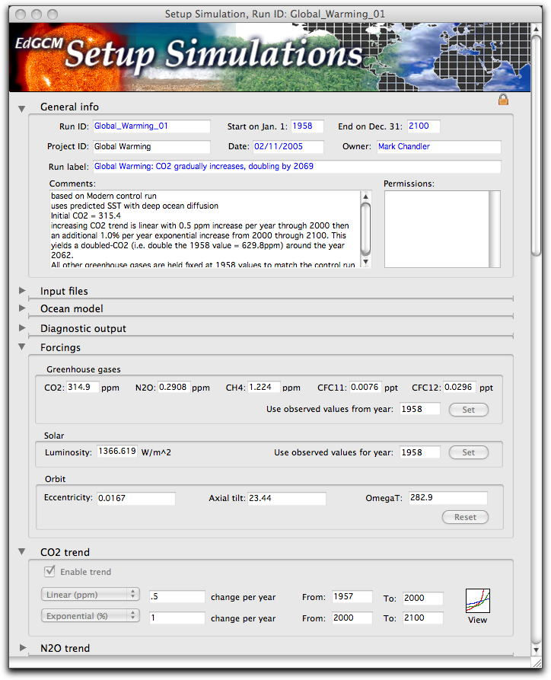
Climate Modeling
EdGCM
No programing
needed at this point

Slide 23
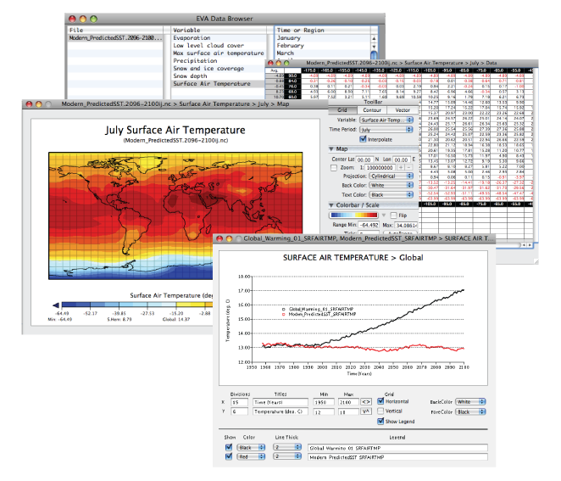
Climate Modeling
EdGCM
Full
Visualization
Package

Slide 24
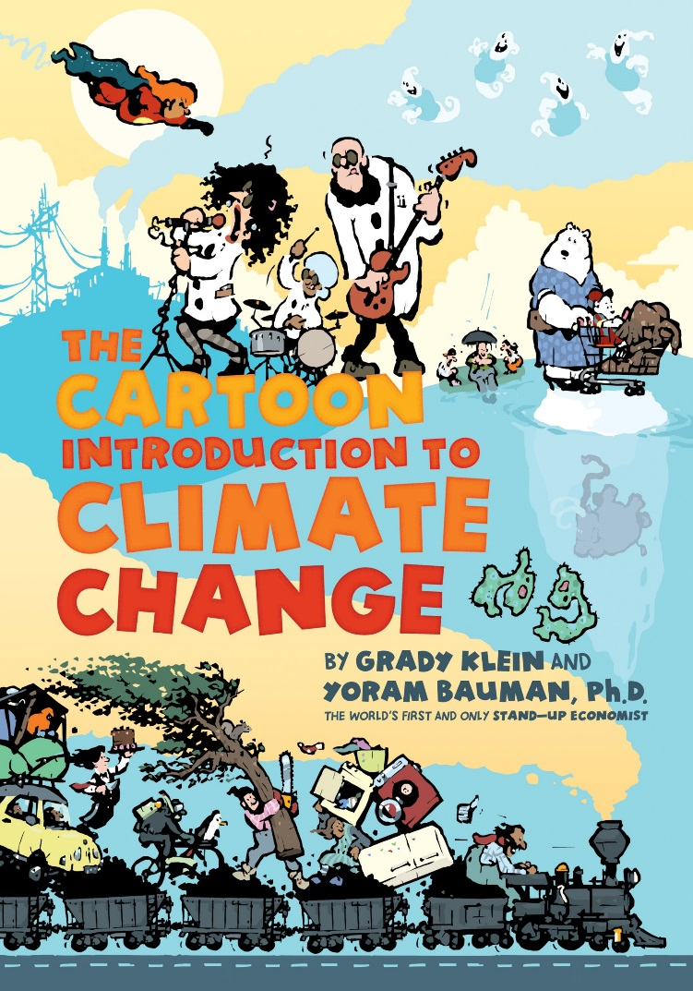
Climate Modeling
Climate Science
Brief introduction in week one

Slide 25
Climate Modeling
Climate Science
Brief introduction in week one
Specific climate topics start in week five
Solar, Atmosphere, Oceans, Cryosphere, Land Processes
Planned multiple guest lectures

Slide 26
Climate Modeling
Climate Science
Brief introduction in week one
Specific climate topics start in week five
Solar, Atmosphere, Oceans, Cryosphere, Land Processes
Planned multiple guest lectures
EdGCM will allow student driven research projects

Slide 27
Going Forward
I would LOVE to share this course with anyone interested
Possible multi-campus course
Further ease teaching a course with so many topics

